Slide 1
React Components & React JS Environment Setup
By Prof. Soleha. A. Sayyed

Slide 2

Introduction to JSX
JSX is a powerful syntax extension in React that makes writing and managing UI components easier and more readable.
It lets developers write HTML-like code directly inside JavaScript.
JSX improves code clarity by combining structure and logic in one place.
It is compiled into regular JavaScript before running in the browser
<h1>Hello, world!</h1> is a JSX element, similar to HTML, that represents a heading tag.
JSX is converted into JavaScript, where React uses React.createElement() to create React elements (virtual DOM representations).

Slide 3
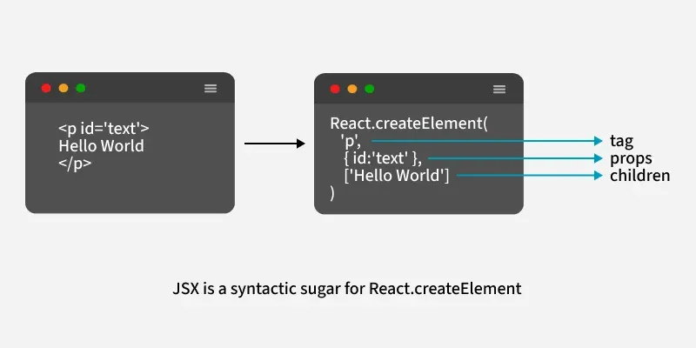
Working of JSX
When React processes this JSX code, it converts it into JavaScript using Babel.
This JavaScript code creates React elements (virtual DOM), which React then uses to update the real browser DOM efficiently.

Slide 4
Implementing JSX in Action
JSX can be implemented in a React project to create dynamic and interactive UI components. Here are the steps to use JSX in a React application:
1. Create a React App
2. Write JSX in the Component: In the src/App.js file, write JSX to display a message:
3. The JSX code <h1>{message}</h1> will be transformed into JavaScript by Babel. Then React will create a virtual DOM element for the <h1> tag with the text inside, and this virtual DOM is then used to update the actual browser DOM, displaying "Hello, JSX works!" on the screen.
4. After React processes the JSX, it renders the message on the screen
import React from "react";
function App() {
const message = "Hello, JSX works!";
return <h1>{message}</h1>;
}
export default App;

Slide 5
Uses of JSX
1. Embedding Expressions
2. Using Attributes in JSX
3. Passing Children in JSX
4. JSX Represents Objects

Slide 6
Expression & Attributes in JSX
JSX allows you to insert attributes into HTML elements, but there are a few important differences.
1. class = className
The class attribute is widely used in HTML, but since JSX is rendered as JavaScript and the class keyword is a reserved word in JavaScript, you are not allowed to use it in JSX.
JSX solved this by using className instead. When JSX is rendered, it translates className attributes into class attributes.
Example
function Car()
{
return (
<h1 className="myclass">Hello World</h1>
);
}

Slide 7
2. Expressions as Attributes
You can also use JavaScript expressions as attribute values. This is very useful for dynamic attributes.
Example
function Car() {
const x = "myclass";
return (
<h1 className={x}>Hello World</h1>
);
}

Slide 8
3. camelCase Event Attributes
Event attributes in JSX are written in camelCase.
Example
function Car() {
const myfunc = () => {
alert('Hello World');
};
return (
<button onClick={myfunc}>Click me</button>
);
}

Slide 9
4. Boolean Attributes
If you pass no value for an attribute, JSX treats it as true. To pass false, you must specify it as an expression.
Example
<button onClick={myfunc} disabled>Click me</button>
5. The style Attribute
The style attribute in JSX only accepts a JavaScript object with camelCased CSS property names, rather than a CSS string (as in HTML).
Example
function Car() {
const mystyles = {
color: "red",
fontSize: "20px",
backgroundColor: "lightyellow",
};
return (
<>
<h1 style={mystyles}>My car</h1>
</> ); }

Slide 10
React JSX Expressions
1. Expressions
You can insert any valid JavaScript expression inside JSX by wrapping it in curly braces { }.
React will evaluate the expression and render the result in the DOM.
Example
Execute the expression 218 * 1.36
function Car() {
return (
<>
<h1>My car</h1>
<p>The calculation is {218 * 1.36} </p>
</>
); }

Slide 11
2. Variables
Variables are also valid expressions. Insert variables in JSX by wrapping it in curly braces { }.
Example
function Car() {
const hp = 218 * 1.36;
return (
<>
<h1>My car</h1>
<p>It has {hp} horsepower</p>
</>
);
}

Slide 12
3. Function Calls
Function calls are valid expressions. Insert function calls in JSX by wrapping it in curly braces { }.
Example
function kwtohp(kw) {
return kw * 1.36;
}
function Car() {
return (
<>
<h1>My car</h1>
<p>It has {kwtohp(218)} horsepower</p>
</>
);
}

Slide 13
4. Object Properties
Access object properties within JSX:
Example:
function Car() {
const myobj = {
name: “Honda Brio",
model: “2012",
color: "white"
};
return (
<>
<h1>My car is a {myobj.color} {myobj.name} {myobj.model}</h1>
</>
);
}

Slide 14
Difference between JS and JSX
.js File | .jsx File
Used for regular JavaScript code. | Used for React components with HTML-like code (JSX).
Doesn’t include JSX syntax. | Includes JSX syntax to define the UI.
Best for writing logic, utility functions, and simple components. | Best for writing UI components that need JSX to render content.
Doesn’t need extra tools to run. | Needs tools like Babel to convert JSX to JavaScript.
Smaller and simpler if just handling logic. | Larger due to JSX code for user interfaces.
Can be used for both JavaScript and React logic. | Focused mainly on creating and rendering UI.

Slide 15
What Are React Components?
Components are a building block that represents a piece of the user interface (UI).
It define the structure and behavior of the UI, either by managing their own state or by receiving data through props and rendering content accordingly.
Components are reusable and can be composed together to build complex UIs in a modular way.
Components can be reused across different parts of the application to maintain consistency and reduce code duplication.
Components manage how their output is rendered in the DOM (Document Object Model) based on their state and props.
React loads only the necessary components, ensuring optimized performance.
Only the specific Component updates instead of the whole page.

Slide 16
Types of React Components
There are two primary types of React components:
1. Functional Components
Functional components are JavaScript functions that return React elements and are the preferred way to build modern React applications.
Can manage state and lifecycle logic using React Hooks.
Use a simpler syntax, making them ideal for reusable components.
Offer better performance by avoiding the use of the this keyword.
Syntax:
function Greet(props) {
return <h1>Hello, {props.name}!</h1>;
}

Slide 17
2. Class Components
Class components are ES6 classes in React that extend React.Component and support state and lifecycle handling.
Manage component data using the this.state property.
Use lifecycle methods such as componentDidMount and componentDidUpdate.
Syntax:
class Greet extends React.Component {
render() {
return <h1>Hello, {this.props.name}!</h1>;
}
}

Slide 18
Core Concepts in React Components
1. Props in React Components
Props (short for properties) are read-only inputs passed from a parent component to a child component. They enable dynamic data flow and reusability.
Props are immutable.
They enable communication between components.
They allow components to be configured and customized from outside.
Syntax:
function Greet(props) {
return <h2>Welcome, {props.username}!</h2>;
}
// Usage
<Greet username="Adam" />;

Slide 19
Example:
Parent Component:
import Car from './car';
function App() {
return <Car brand=“BMW" />;
}
Child Component
function Car(props) {
return <h1>I am a {props.brand}!</h1>;
}
Output:
I am a BMW!

Slide 20
2. State in React Components
State is a component-controlled JavaScript object used to store and manage dynamic
data over time.
Updating state automatically triggers a re-render.
Functional components manage state using the useState hook.
Syntax:
function Counter() {
const [count, setCount] = React.useState(0);
return (
<div>
<p>Count: {count}</p>
<button onClick={() =>
setCount(count + 1)}>Increment</button>
</div>
);
}

Slide 21
3. Rendering a Component
Rendering in React means displaying a component in the browser’s DOM, and React automatically updates the UI when a component’s props or state change.
Components must be imported before they can be rendered
ReactDOM.render() is typically used in the root file to mount the app
Syntax:
ReactDOM.render(<Greeting name="Emma" />, document.getElementById('root’));
4. Nested Components
In React, you can nest components inside other components to build a modular and hierarchical structure.
Components can be reused multiple times within the same or different components.
Props can be passed to nested components for dynamic content.
Promotes code reusability and better component organization.

Slide 22
Syntax:
function Header() {
return <h1>Welcome to My Site</h1>;
}
function Footer() {
return <p>2024 My Company</p>;
}
function App() {
return (
<div>
<Header />
<p>This is the main content.</p>
<Footer />
</div>
);
}
export default App;

Slide 23
3. Child Components:
The Child component is a component that is nested inside another component, known as the parent component.
This hierarchical relationship allows for better organization, modularity, and reusability of code.
Parent-Child Relationship: A parent component can pass data to a child component
using props.
Props: Short for properties, props are how data is passed from parent to child. They are
read-only in the child component.
Example:
function Child({ onButtonClick }) {
return <button onClick={onButtonClick}>Click Me</button>;
}
function Parent() {
const handleClick = () => alert("Button clicked in child!");
return <Child onButtonClick={handleClick} />;
}

Slide 24
4. Namespaced Components
Namespaced components in React refer to a pattern where related components are grouped together under a parent component using dot notation.
This approach helps organize and structure your component hierarchy, especially for components that have a strong logical or structural relationship.
Instead of exporting each related component individually, you attach them as properties to a main or parent component.
This creates a "namespace" where the sub-components are accessed through the parent.
Example: // App.js
import Form from './Form';
function App() {
return (
<Form>
<Form.Input type="text" placeholder="Enter name" />
<Form.Button>Submit</Form.Button>
</Form> );}

Slide 25
// Form.js
function Form({ children }) {
return <form>{children}</form>;
}
Form.Input = function Input(props) {
return <input {...props} />;
};
Form.Button = function Button(props) {
return <button {...props} />;
};
export default Form;

Slide 26
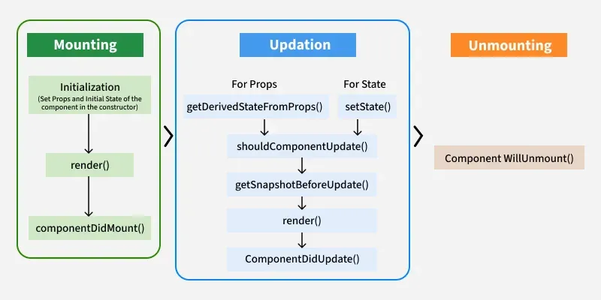
React Component Lifecycle:
It’s created, The React lifecycle refers to the different phases a component goes through during its time in a React application.
These phases allow you to run specific code at key moments in a component's life, such as when updated, or removed from the screen.
Here are the three main phases of the React component lifecycle:

Slide 27
1. Mounting Phase:
Mounting refers to the process of creating and inserting a component into the DOM for the first time in a React application.
During mounting, React initializes the component, sets up its internal state (if any), and inserts it into the DOM.
1. constructor(props):
First method called when the component is created.
Used to initialize state and bind methods.
Example:
class MyComponent extends React.Component {
constructor(props) {
super(props);
this.state = { count: 0 };
console.log(“constructor");
}
}

Slide 28
2. static getDerivedStateFromProps(props, state)
Called before rendering, both on the initial mount and on updates.
Rarely used, but lets you update state based on props. It must return an object to update the state or null to do nothing.
Example:
static getDerivedStateFromProps(props, state) {
return null; // or return an updated state object
}
3. render()
The only required method in a class component.
Returns the JSX that defines the UI.
Should be pure (no side effects).
Example:
render() {
return <div>Hello World</div>;
}

Slide 29
4. componentDidMount():
Invoked immediately after the component is mounted (inserted into the DOM).
Perfect for:
Fetching data
Starting animations
Setting up subscriptions
Interacting with the DOM
Example:
componentDidMount() {
console.log("Component did mount");
fetch('/api/data').then(...);
}

Slide 30
2. Updating Phase:
Its state changes via this.setState() (class) or useState setter (functional)
It receives new props from a parent component
A force update is triggered using forceUpdate() (rare)
1. getDerivedStateFromProps: getDerivedStateFromProps(props, state) is a static method that is called just before the render() method in both the mounting and updating phase in React. It takes updated props and the current state as arguments.
Example:
static getDerivedStateFromProps(props, state) {
if (props.name !== state.name) {
return { name: props.name }; // Update state with new props
}
return null; // No state change }

Slide 31
2. setState(): This is not particularly a Lifecycle function and can be invoked explicitly at any instant. This function is used to update the state of a component.
Example:
this.setState((prevState, props) => ({
counter: prevState.count + props.diff
}));
3. shouldComponentUpdate(): shouldComponentUpdate() Is a lifecycle method in React class components that determines whether a component should re-render.
It compares the current and next props/states and returns true if the component should update or false if it should not.
Example:
shouldComponentUpdate(nextProps, nextState)
It returns true or false, if false, then render(), componentWillUpdate(), and componentDidUpdate() method does not get invoked.

Slide 32
4. getSnapshotBeforeUpdate() Method: The getSnapshotBeforeUpdate() method is invoked just before the DOM is being rendered.
It is used to store the previous values of the state after the DOM is updated.
Example:
getSnapshotBeforeUpdate(prevProps, prevState)
5. componentDidUpdate(): Similarly, this function is invoked after the component is rendered, i.e., this function gets invoked once after the render() function is executed after the updation of State or Props.
Example:
componentDidUpdate(prevProps, prevState, snapshot)

Slide 33
3. Unmounting
This is the final phase of the lifecycle of the component, which is the phase of unmounting the component from the DOM. The following function is the sole member of this phase.
componentWillUnmount()
This function is invoked before the component is finally unmounted from the DOM, i.e., this function gets invoked once before the component is removed from the page, and this denotes the end of the lifecycle.
Example:
class Child extends React.Component {
componentWillUnmount() {
alert("The component named Header is about to be unmounted.");
}
render() {
return (
<h1>Hello World!</h1>
); }

Slide 34
Component composition and reuse
Component composition is the practice of combining multiple smaller components to create a more complex UI.
In React.js, components can be nested within one another, allowing developers to create a hierarchical structure of components.
The outer components can encapsulate the inner components and manage their behavior and rendering.
Component composition is achieved through the concept of parent and child components.
A parent component wraps one or more child components and controls their rendering, behavior, and state.
This creates a tree-like structure, where components can be organized into a parent-child relationship.

Slide 35
Advantages of Component Composition
Modularity
Separation of Concerns
Code Reusability
Testing and Debugging
Reuse React components:
When creating reusable React components, it's important to keep in mind two key factors:
1. Avoid side effects:
It is not recommended to include logic that interacts with external data, such as making API calls, directly inside a reusable component.
Instead, you should pass this logic as props to the component.
For example, if a button not only has a visual function but also fetches data from the internet, it may not be reusable in other contexts.

Slide 36
Example:
// It is a reusable button component, and this is a bad practice
const ButtonReusable = () => {
return (
<button> Click Me </button>
);
}
2. Use Props:
Props are parameters passed to a component to customize its behavior and appearance, making it reusable for different purposes.
// It is a reusable button component that can change its color
const ButtonReusable = ({ color }) => {
return (
<button style={{ backgroundColor: blue }}> Click Here </button>
);}

Slide 37
Writing your first React.js component
To create your first React.js component, follow these steps:
1. Set up your React environment: If you don't already have one, you'll need a React project. The easiest way to get started is by using Create React App:
npx create-react-app my-first-react-app
cd my-first-react-app
2. Create a new component file:
Inside the src folder of your React project, create a new file for your component. It's standard practice to capitalize the first letter of component file names and use the .jsx extension (though .js will also work).
For example, filename.jsx.
3. Define the functional component:
Open filename.jsx and define a functional component that returns JSX (JavaScript XML). Remember that component names must start with a capital letter.

Slide 38
Example:
// filename.jsx
import React from 'react';
function MyComponent()
{
return (
<div>
<h1>Hello from my first React component!</h1>
<p>This is a simple paragraph within the component.</p>
</div>
);
}
export default filename;

Slide 39
// App.js
import React from 'react';
import filename from './filename';
// Adjust path if needed
import './App.css';
function App()
{
return (
<div className="App">
<header className="App-header">
<filename />
{/* Your component is rendered here */}
</header>
</div>
); }
export default App;

Slide 40
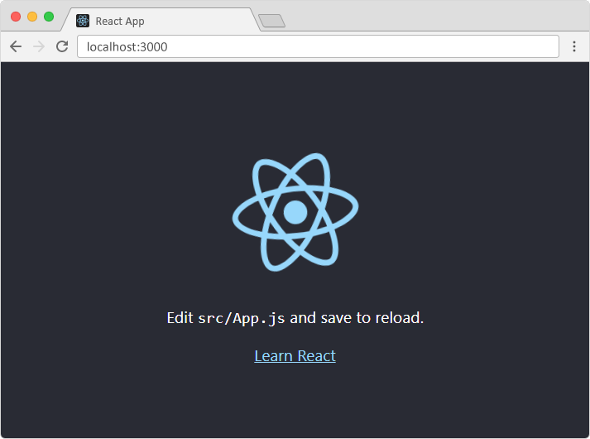
Run your React application: Save all files and navigate to your project directory in the terminal, then run:
npm start
This will open your application in the browser, and you should see the content rendered by filename.

